Slide 1



UNIVERSITY INSTITUTE OF
ENGINEERING ELECTRICAL ENGINEERING
Bachelor of Engineering
Energy Resources, Economics & Environment Subject Code:ELC-351
Harpreet Kaur (E-1496)
ENERGY RESOURCES
DISCOVER . LEARN . EMPOWER

Slide 2
ENERGY RESOURCES
Will be covered in this lecture
Course Outcome
CO Number | Title | Level
CO1 | understand the key concept of energy economics and factors affecting energy markets. | Understand
CO2 | apply the concept of differential equations and to impart the knowledge of their applications for the calculation of payback period. | Apply
CO3 | analyze specific energy issues globally and environmental impact of using different forms of energy. | Analyze
CO4 | Analyze the impact of air pollutants on human health | Analyze
CO5 | Evaluate the Kyoto protocol to calculate CO2 emission | Evaluate
2

Slide 3
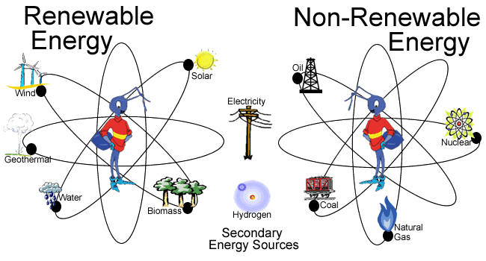
ENERGY RESOURCE
Figure 1 Classification of energy resources[1]
It is something that can produce heat, power life, move objects, or produce electricity.
A fuel is a Matter that stores energy
Classified into:
Conventional(Non Renewable)
Non Conventional.(Renewable)
3

Slide 4
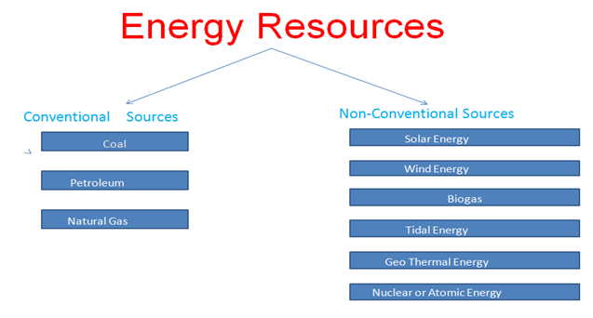
DIFFERENT ENERGY RESOURCES
Figure 2 energy resources Classification[2]

Slide 5
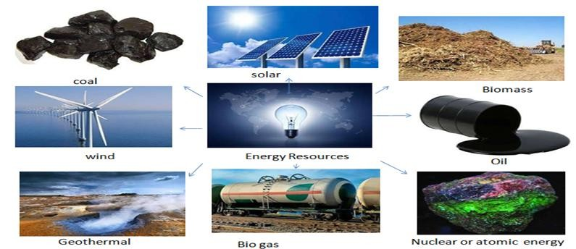
CLASSIFICATION OF ENERGY RESOURCES
Figure 3 Different energy resources[3]

Slide 6
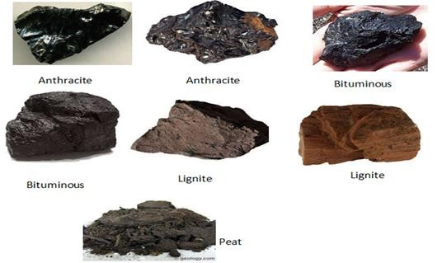
DIFFERENT TYPES OF COAL
It is an inflammable organic substance composed of carbons found in sedimentary rocks.
Figure 4 Different Types of coal[4]

Slide 7
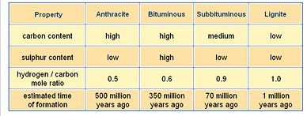
COMPARISON OF DIFFERENT TYPES OF COAL
http://www.eurekaelearning.com/index.php/resources/fuel_oil_coal_natural_gas
_distillation_crude_methane_organic_molecule_t_page_5.html [5]

Slide 8
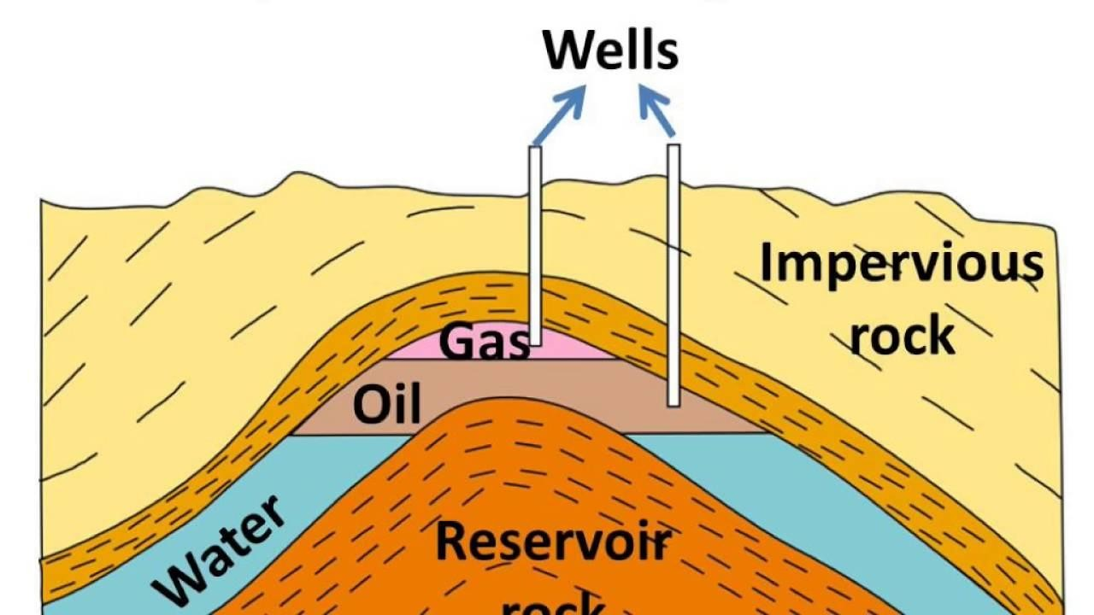
FORMATION OF PETROLEUM
Petroleum formed due to compression of animals or human beings over million years under great heat and pressure.(Fat turned into oil).
Ex- On-shore (Animals/Human Beings)
Off-Shore(Marine creatures)
Figure 5 Formation of petroleum[6]

Slide 9
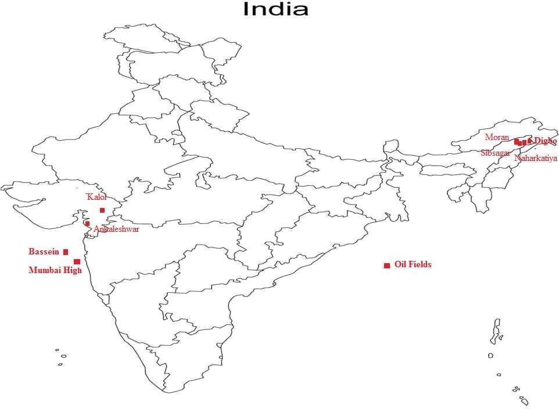
DISTRIBUTION OF PETROLEUM IN INDIA
Figure 6 Distribution of petroleum in India[7]

Slide 10
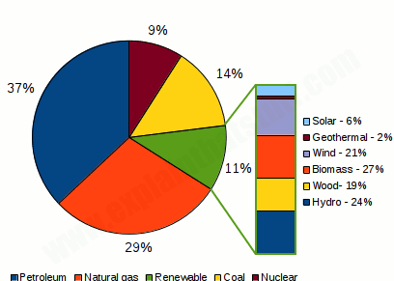
% USAGE OF DIFFERENT ENERGY RESOURCS
Figure 7 % usage of different energy resources[8]

Slide 11
Assessment Pattern
Following point will be used to assess students performance
Group Discussion
Assignment
Quiz

Slide 12
Assessment Pattern
Scheme
ELC-351 | Energy Resources, Economics & Environment | L | T | P | C
 | Total Contact Hours :45 | 3 | 0 | 0 | 3
 | Applicable to which branch: EE,EEE
Internal | External | Total
40 | 60 | 100

Slide 13
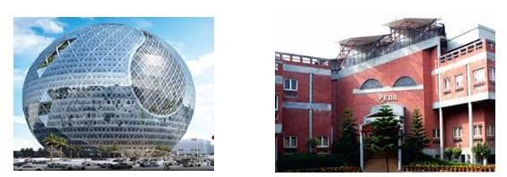
APPLICATIONS
Different energy resources are used for Commercial use of energy
Figure 8 Solar powered Buildings[9]

Slide 14
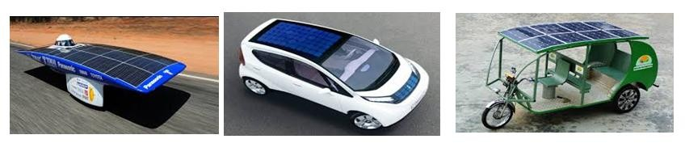
APPLICATIONS
Different energy resources are used for Transportation purpose
Figure 9 Solar powered vehicles[10]
14

Slide 15
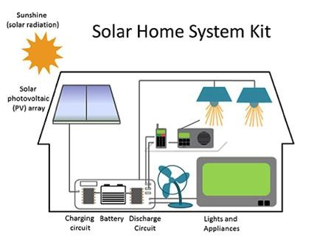
APPLICATIONS
Different energy resources are
used for Residential use of energy
Figure 10 Solar powered vehicles[10]
16

Slide 16
REFERENCES
https://slideplayer.com/slide/7441052/
https://gradestack.com
https://www.eschooltoday.com
http://www.topsampler.com/
http://www.eurekaelearning.com/index.php/resources/fuel_oil_coal_natural_gas_distillation_crude_methane_org
anic_molecule_t_page_5.html
https://energyeducation.ca
https://neostencil.com/petroleum-and-its-distribution
https://beta.grafiti.io/facts/51018
http://peda.gov.in/main/
www.wired.com/story/solar-power-electric-cars
https://www.makeuseof.com/tag/12-awesome-solar-powered-gadgets-every-home-using
17

Slide 17

THANK YOU
For queries
Email: harpreet.ee@cumail.in

